Slide 1
Improve Unit Tests(HTMClassifier)
Team: CodeBD
Debasish Dutta
Matriculation No. 1343753
Prof. Dr. Andreas Pech & Prof. Damir Dobric
Frankfurt University of Applied Sciences
Software Engineering
30th March, 2022

Slide 2
TABLE OF CONTENTS
01
02
03
INTRODUCTION
04
TEST CASES AND RESULTS
CONCLUSION
BIBLIOGRAPHY

Slide 3
INTRODUCTION
This study provides Hierarchical Temporal Memory (HTM), a machine learning approach that uses Spatial Pooler, Scalar Encoder and Temporal memory where Unit Tests are done on the learned data to be congruent with the expected output.
Hierarchical Temporal Memory (HTM) theory, which represents the structural and algorithmic aspects of neocortex, has recently developed a new paradigm in machine intelligence.
The agility after testing the sequentially learned data while coinciding them with the input and output is the actual goal.

Slide 4
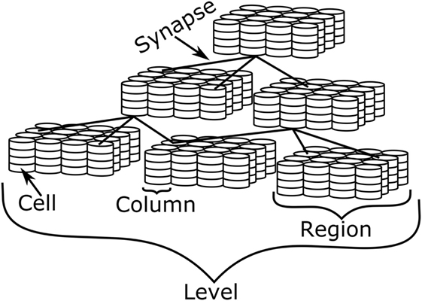
INTRODUCTION
Figure 1: Illustration of the many levels of detail in HTM.

Slide 5
INTRODUCTION
To begin with, the brain is a hierarchical organization by nature. Signals flow in both ways along the hierarchy.
Additionally, there is signal flow within the region. Second, all of the information stored in the brain is temporal.
All aspects of brain learning revolve around the concept of time.
Finally, the human brain functions primarily as a memory system. Over time, we try to remember and predict patterns. In a way, all of the cells and their connections are storing the patterns that have been observed through time.

Slide 6
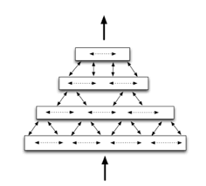
INTRODUCTION
Figure 2: Illustration of the many levels of detail in HTM.

Slide 7
TEST CASES AND RESULTS
Through the GetPredictedInputValues() method, I've worked on or tested three public methods. The following is a breakdown of the methods' workings.
Some functions, on the other hand, didn't necessitate unit testing because they don't have any expected return values.
ActiveMap2.Clear() is present in the initial method ClearState, but it lacks the functionality needed to be tested in a unit test. Learn(TIN input, Cell[] output) is the second function's Learn(TIN input, Cell[] output) where the learning process begins after this technique, from whence we acquired the sequences that determine the HTM region parameters.

Slide 8
TEST CASES AND RESULTS
The very first standard method on which I worked is CheckHowManyOfGetPredictedInputValues() where I have checked that the data sent through ‘howMany’ parameters are equal to the ‘res’ variable value which is counted by Count==howMany.
So, the goal we set for our GetPredictedInputValues() method is being met by this unit test.

Slide 9
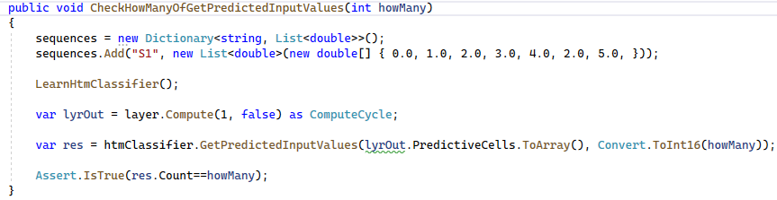
TEST CASES AND RESULTS
This code snippet checks that the 'howMany' parameter value is equal to the Count==howMany variable value.

Slide 10
TEST CASES AND RESULTS
The next function, NoExceptionIfCellsCountIsZero(), demonstrates that if we send cells count '0', it checks for the exception.
CheckHowManyOfGetPredictedInputValues(), on the other hand, does not throw an exception in this instance.
So, it is maintained that the method htm.Classifier.GetPredictedInputValues() returns the precise number of predicted input values that we sought to forecast.

Slide 11
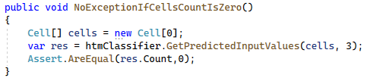
TEST CASES AND RESULTS
NoExceptionIfCellsCountIsZero() where it is showing that if we send cells count ‘0’, it checks for the exception.

Slide 12
TEST CASES AND RESULTS
The third and the last unit test plays very important role for the HTMClassifier. I examine the input sequence and output sequence is same after learning our data through the method LearHtmClassifier().
For example, here in the code below is demonstrating that the input sequence-3 is equal to output sequence-3 after checking through the predicted method, GetPredictedInputValues().

Slide 13
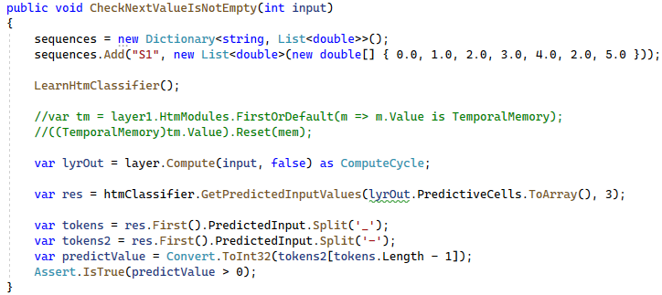
TEST CASES AND RESULTS
It tests the input sequence and output sequence are same after learning our data through the method LearHtmClassifier().

Slide 14
CONCLUSION
In conclusion, I have proposed here three new unit tests, which I validate and benchmark against existing ones.
Using datasets from the spatial pooler, the scalar encoder, and the temporal memory repository, I evaluated the performance of my suggested unit tests for the HTM-Classifier.
I will focus on further enhancing the classifier design and investigating the application of the HTM-Classifier for HTM Classifier issues, among other things.

Slide 15
BIBLIOGRAPHICAL REFERENCES
● Abdullah M. Zyarah, Kevin Gomez, and Dhireesha Kudithipudi (2000). End-to-End Memristive HTM System for Pattern Recognition and Sequence Prediction.
● Dobrick, D. (2021). Improved HTM Spatial Pooler with. Retrieved from University of Plymouth.
● Jie Cheng & Russell Greiner (2001). Learning Bayesian Belief Network Classifiers: Algorithms and System.
● Yuwei Cui, Chetan Surpur, Subutai Ahmad, and Jeff Hawkins (2016).
A comparative study of HTM and other neural network models for online sequence learning with streaming data.
● Xia Zhituo, Ruan Hao, Wang Hao (2012). A Content-Based Image Retrieval System Using Multiple Hierarchical Temporal Memory Classifiers.

Slide 16
THANK YOU

